Slide 1
5. Continuous Random Variables

Slide 2
Contents
1 Understanding Continuous Random Variables,
PDF, CDF
2 E(X) and Var(X) of Continuous Random Variables
3 The Uniform Random Variable
4 Normal Random Variables
5 Exponential Random Variables
6 Other Continuous Distributions

Slide 3
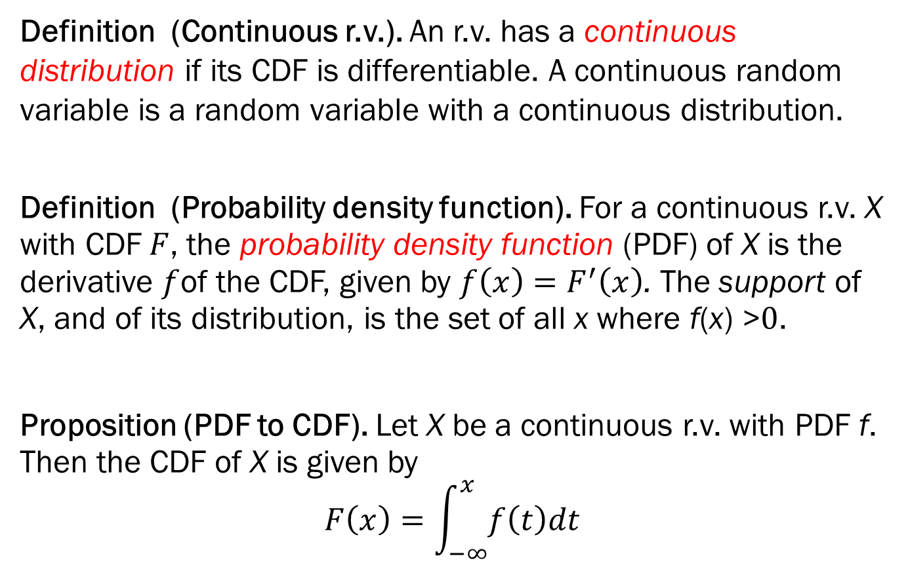
5.1 Understanding Continuous Random Variables
Definition (Continuous r.v.). An r.v. has a continuous distribution if its CDF is differentiable. A continuous random variable is a random variable with a continuous distribution.
Definition (Probability density function). For a continuous r.v. X with CDF$F$, the probability density function (PDF) of X is the derivative $f$of the CDF, given by $f\left(x\right)=F^{′}\left(x\right)$. The support of X, and of its distribution, is the set of all x where f(x) >$0$.
Proposition (PDF to CDF). Let X be a continuous r.v. with PDF f. Then the CDF of X is given by $$F\left(x\right)=\int_{−∞}^{x}{f\left(t\right)dt}$$

Slide 4
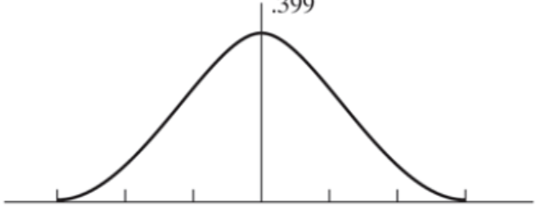
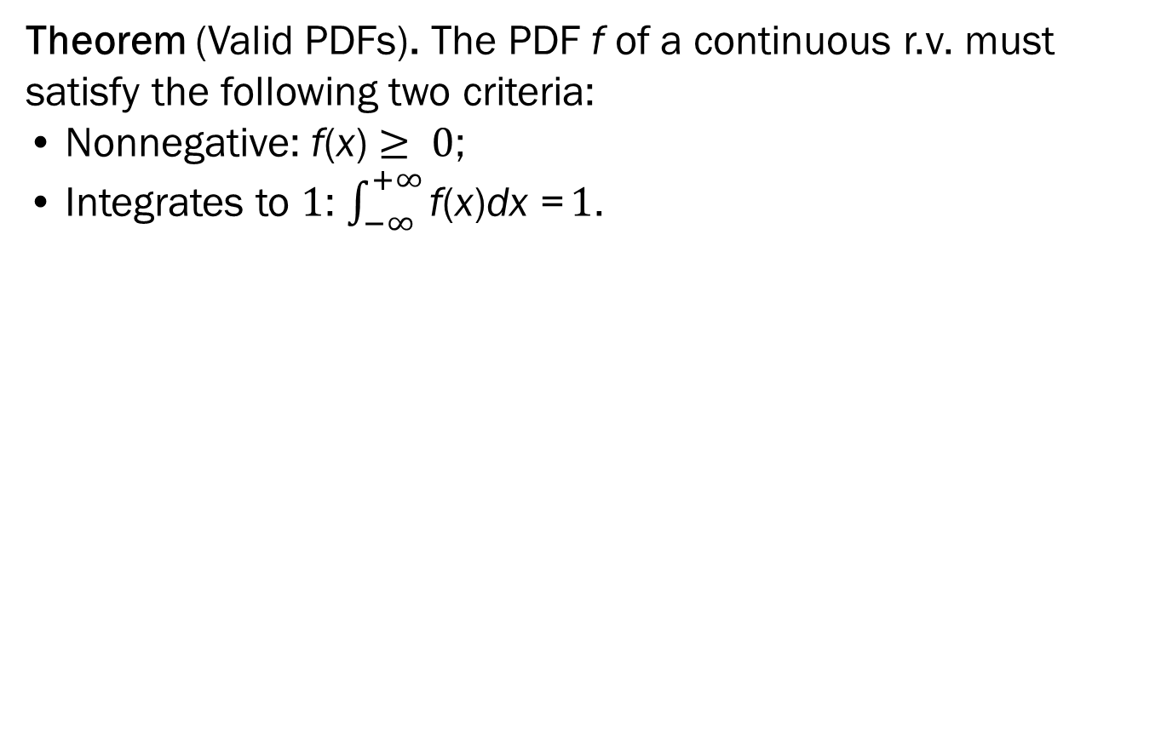
Continuous Random Variables
Theorem (Valid PDFs). The PDF f of a continuous r.v. must satisfy the following two criteria: • Nonnegative: f(x) $≥ 0$; • Integrates to $1$: $\int_{−∞}^{+∞}{\text{f}\text{(}\text{x}\text{)}\text{dx}\text{ =}}1$.

Slide 5
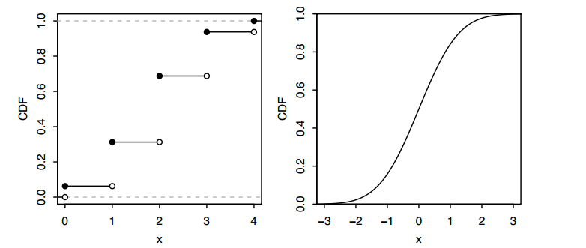
CDFs of discrete and continuous r.v.

Slide 6
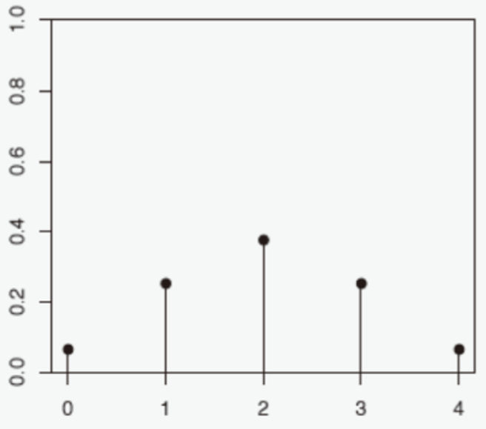
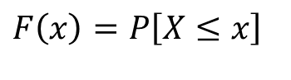
PMF of discrete and PDF of continuous r.v.
$$F\left(x\right)=P\left[X≤x\right]$$
PMF
PDF

Slide 7
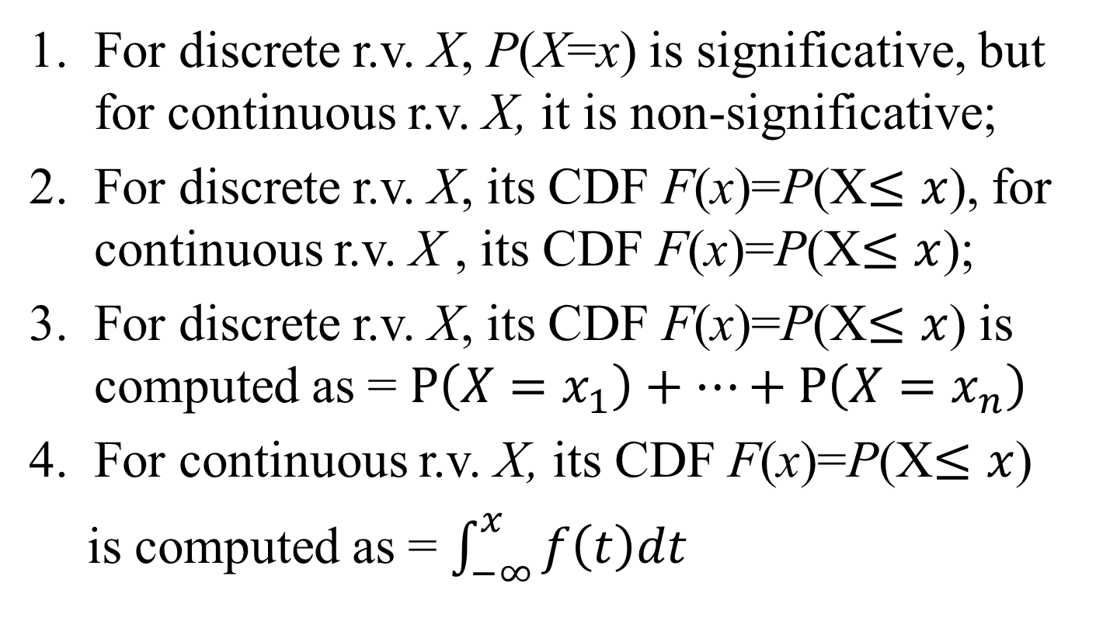
Differences of discrete and continuous r.v.
For discrete r.v. X, P(X=x) is significative, but for continuous r.v. X, it is non-significative;
For discrete r.v. X, its CDF F(x)=P(X$≤x$), for continuous r.v. X , its CDF F(x)=P(X$≤x$);
For discrete r.v. X, its CDF F(x)=P(X$≤x$) is computed as = $P\left(X=x_{1}\right)+⋯+P\left(X=x_{n}\right)$
For continuous r.v. X, its CDF F(x)=P(X$≤x$)
is computed as = $\int_{−∞}^{x}{f\left(t\right)dt}$

Slide 8
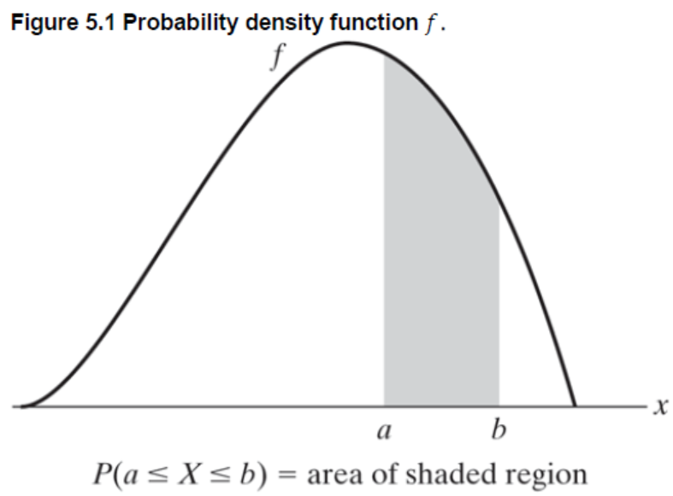
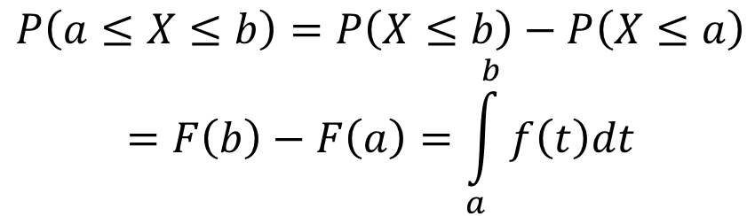
Probability of continuous r.v.
$$P\left(a≤X≤b\right)=P\left(X≤b\right)−P\left(X≤a\right)$$
$$=F\left(b\right)−F\left(a\right)=\int_{a}^{b}{f\left(t\right)dt}$$

Slide 9
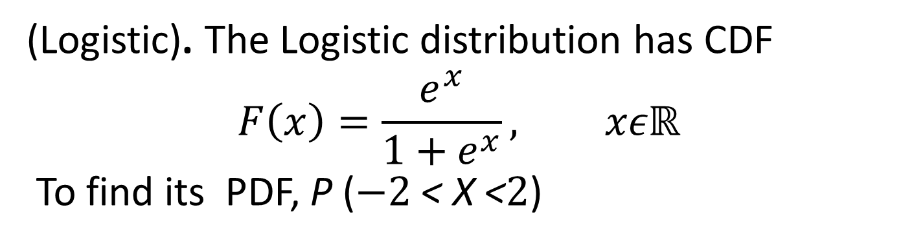
Example 5.a Logistic distribution
(Logistic). The Logistic distribution has CDF
$$F\left(x\right)=\frac{e^{x}}{1+e^{x}}, xεℝ$$
To find its PDF, P ($−2$< X <$2$)

Slide 10
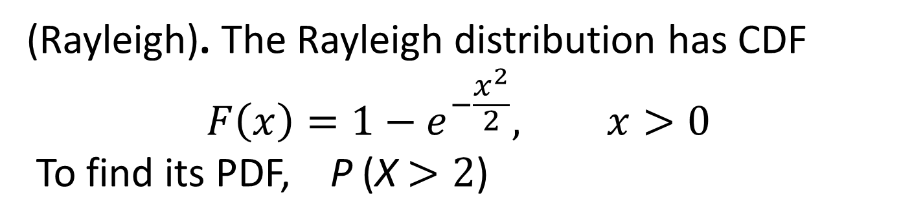
Example 5.b Rayleigh distribution
(Rayleigh). The Rayleigh distribution has CDF
$$F\left(x\right)=1−e^{−\frac{x^{2}}{2}}, x>0$$
To find its PDF, P (X $>2$)

Slide 11
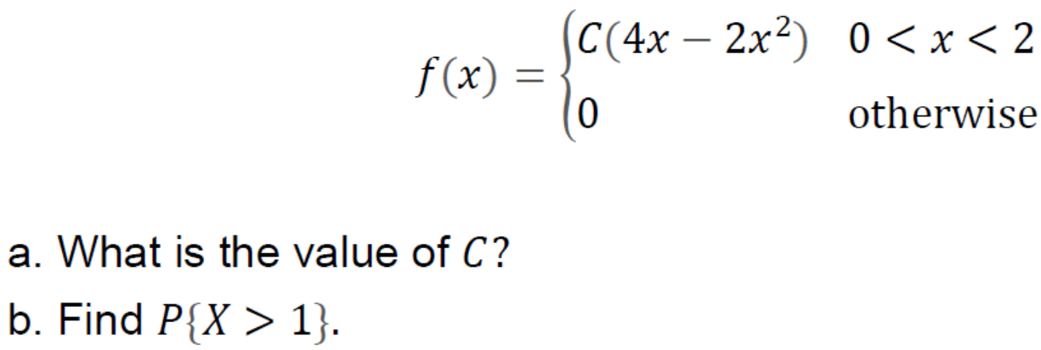
Example 5.c Validation of a PDF
(Validation). Given a r.v. X its pdf is as follows,

Slide 12
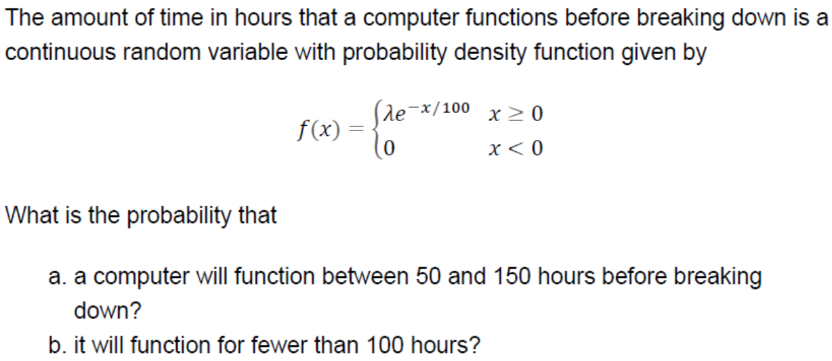
Exercise

Slide 13
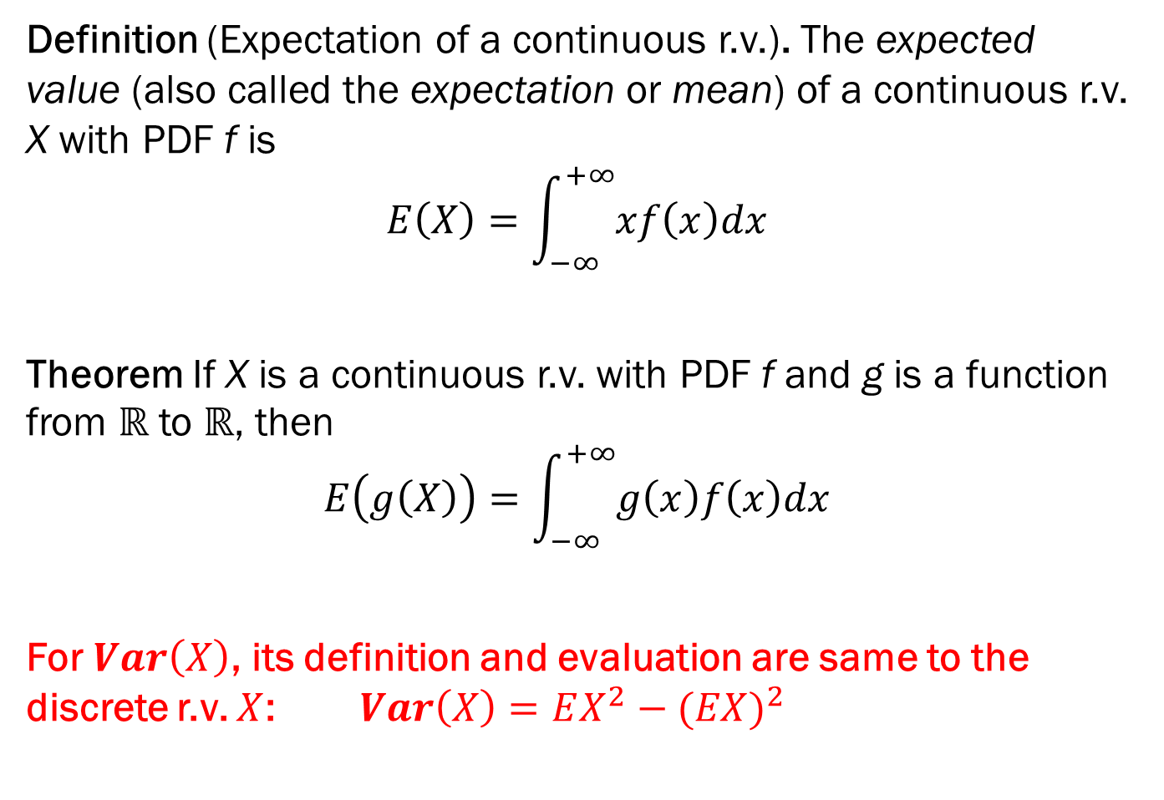
5.2 E(X) and Var(X) of Continuous R.V.
Definition (Expectation of a continuous r.v.). The expected value (also called the expectation or mean) of a continuous r.v. X with PDF f is
$$E\left(X\right)=\int_{−∞}^{+∞}{xf\left(x\right)dx}$$
Theorem If X is a continuous r.v. with PDF f and g is a function from $ℝ$ to $ℝ$, then $$E\left(g\left(X\right)\right)=\int_{−∞}^{+∞}{g\left(x\right)f\left(x\right)dx}$$
For $Var\left(X\right)$, its definition and evaluation are same to the discrete r.v. $X$: $Var\left(X\right)=EX^{2}−{(EX)}^{2}$

Slide 14
Discrete versus continuous
p.m.f. f(x)
p.d.f. f(x)
P(X ≤ a)
∑_{x ≤ a} f(x)
∫_{x ≤ a} f(x)dx
E[X]
∑_{x} x f(x)
∫_{x} x f(x)dx
E[X²]
∑_{x} x² f(x)
∫_{x} x² f(x)dx
Var[X]
E[(X – E[X])²] = E[X²] – E[X]²

Slide 15
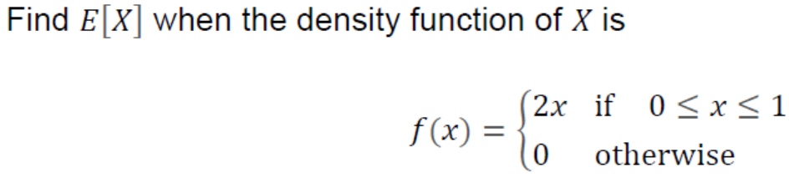
Example 5.d Given PDF, evaluate E(X) Var(X)
(Validation). Given a r.v. X its pdf is as follows,

Slide 16
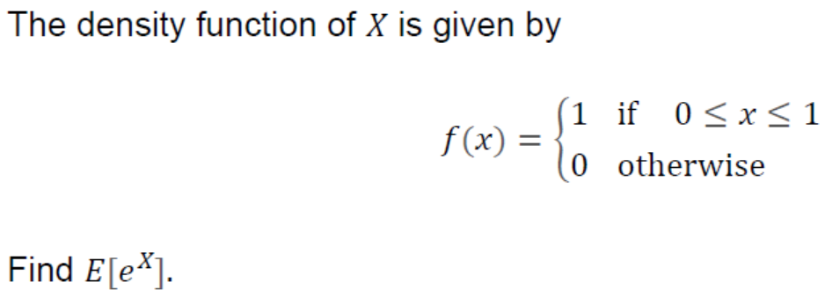
Example 5.e Given PDF, evaluate E(X) Var(X)
(Validation). Given a r.v. X its pdf is as follows,

Slide 17

5.3 Uniform distribution
A package is to be delivered between noon and 1pm.
When will it arrive?

Slide 18
The uniform random variable
Sample space S = [0, 60)
Events of interest:
intervals [x, y) ⊆ [0, 60)
their intersections, unions, etc.
Probabilities:
P([x, y)) = (y – x)/60
Random variable:
X(ω) = ω

Slide 19
How to do calculations
You walk out of the apartment from 12:30 to 12:45. What is the probability you missed the delivery?
Solution
Event of interest: E = [30, 45) or E = “30 ≤ X < 45”
E
0
60
P(E) = (45 – 30)/60 = 1/4

Slide 20
How to do calculations
From 12:08 - 12:12 and 12:54 - 12:57 the doorbell wasn’t working.
Event of interest: E = “8 ≤ X < 12” ∪ “54 ≤ X < 57”
0
60
P(E) = P([8, 12)) + P([54, 57)) = 4/60 + 3/60 = 7/60

Slide 21
Uniform random variable
A random variable X is Uniform(0, 1) if its p.d.f. is
1
if x ∈ (0, 1)
f(x)
f(x) =
0
if x < 0 or x > 1
A Uniform(a, b) has p.d.f.
1/(b - a)
if x ∈ (a, b)
f(x) =
0
if x < a or x > b
X
a
b

Slide 22
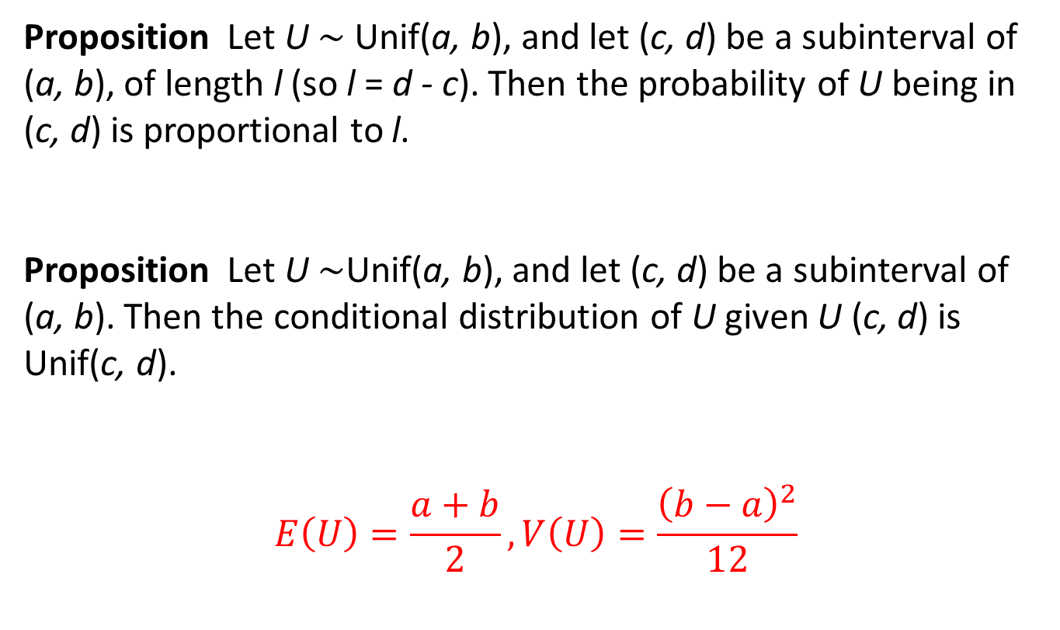
Uniform random variable
Proposition Let U $\sim$ Unif(a, b), and let (c, d) be a subinterval of (a, b), of length l (so l = d - c). Then the probability of U being in (c, d) is proportional to l.
Proposition Let U $\sim$Unif(a, b), and let (c, d) be a subinterval of (a, b). Then the conditional distribution of U given U (c, d) is Unif(c, d).
$$E\left(U\right)=\frac{a+b}{2}, V\left(U\right)=\frac{{\left(b−a\right)}^{2}}{12}$$

Slide 23

Example 5.f Waiting for a friend
Your friend said she’ll show up between 7 and 8 but probably around 7.30.
It is now 7.30.
What is the probability you have to wait past 7.45?

Slide 24
Waiting for a friend
Probability model
Let’s assume arrival time X has following p.d.f.:
f(x)
1/30
x
0
30
60
We want to calculate
P(X > 45)
P(X > 45 | X > 30)
=
P(X > 30)

Slide 25
Waiting for a friend
f(x)
1/30
x
0
30
45
60
⁶⁰
= 1/2
P(X > 30) = ∫₃₀ f(x)dx
⁶⁰
= 1/8
P(X > 45) = ∫₄₅ f(x)dx
so P(X > 45 | X > 30) = (1/8)/(1/2) = 1/4.

Slide 26
Interpretation of the p.d.f.
The p.d.f. value f(x) δ approximates the probability that X in an interval of length δ around x
P(x – δ ≤ X < x) = f(x) δ + o(δ)
P(x ≤ X < x + δ) = f(x) δ + o(δ)
Example
1/60
If X is uniform, then
f(x) = 1/60
P(x ≤ X < x + δ) = δ/60
δ
x

Slide 27
Uniform random variable
A random variable X is Uniform(0, 1) if its p.d.f. is
1
if x ∈ [0, 1]
f(x) =
0
if x < 0 or x > 1
f(x)
μ
∫₀ f(x)dx
¹
= ∫₀ dx = 1
¹
μ – σ
μ + σ
E[X] = ∫₀ x f(x)dx
= x²/2|₀
= 1/2
¹
¹
¹
= x³/3|₀
= 1/3
μ = E[X]
σ = √Var[X]
E[X²] = ∫₀ x² f(x)dx
¹
Var[X] = 1/3 – (1/2)² = 1/12
x
√Var[X] = 1/√12 ≈ 0.289

Slide 28
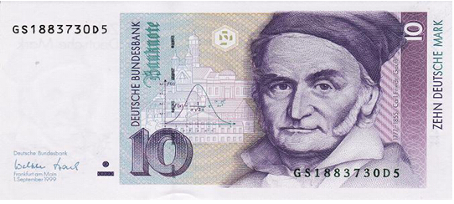
5.4 Normal distribution
Three important symmetry properties
Symmetry of PDF
Symmetry of tail areas
Symmetry of Z and +Z

Slide 29
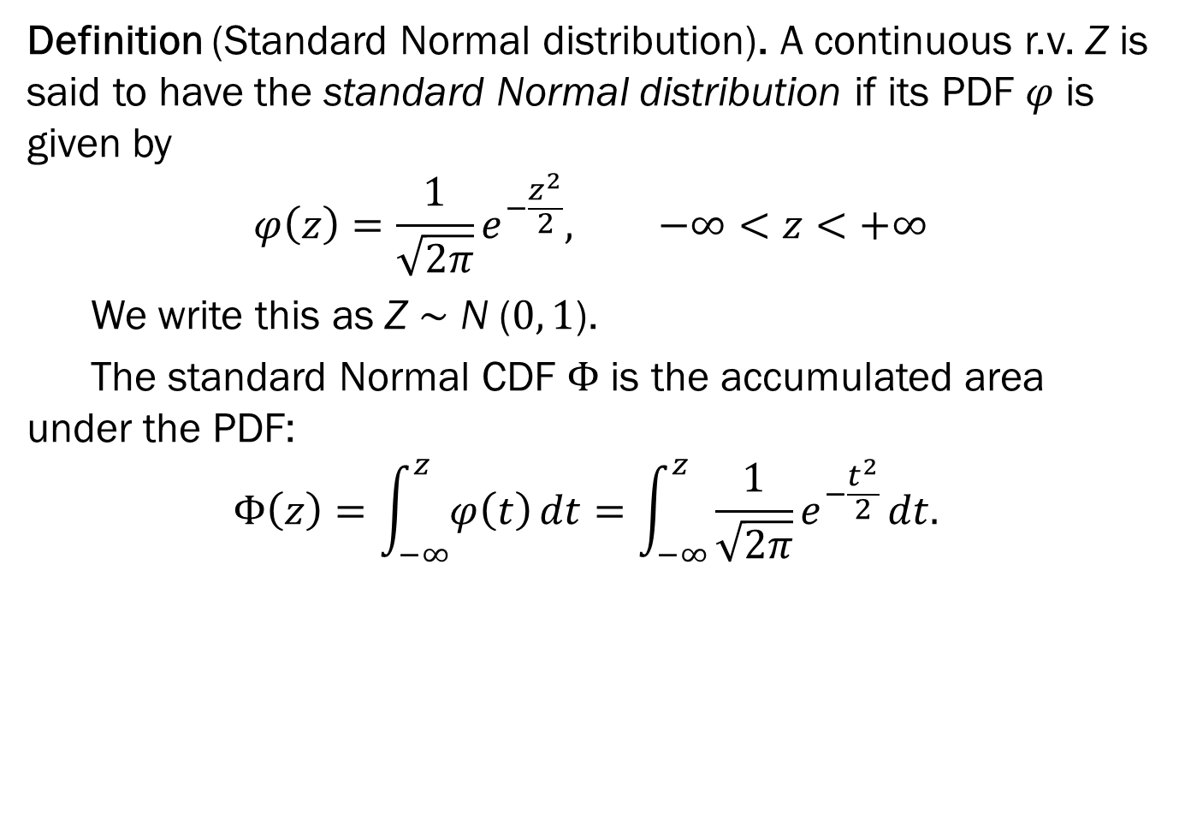
5.4 Normal distribution
Definition (Standard Normal distribution). A continuous r.v. Z is said to have the standard Normal distribution if its PDF $φ$ is given by
$$φ\left(z\right)=\frac{1}{\sqrt{2π}}e^{−\frac{z^{2}}{2}}, −∞<z<+∞$$
We write this as Z $\sim$ N ($0, 1$).
The standard Normal CDF $Φ$ is the accumulated area under the PDF: $$Φ\left(z\right)=\int_{−∞}^{z}{φ\left(t\right)}dt=\int_{−∞}^{z}{\frac{1}{\sqrt{2π}}e^{−\frac{t^{2}}{2}}}dt.$$

Slide 30
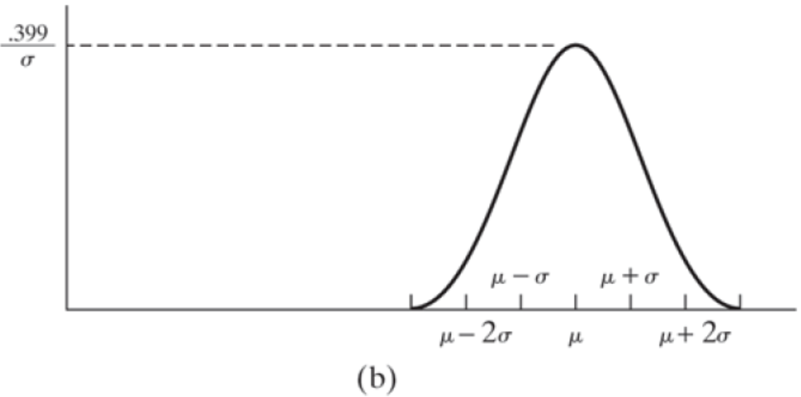
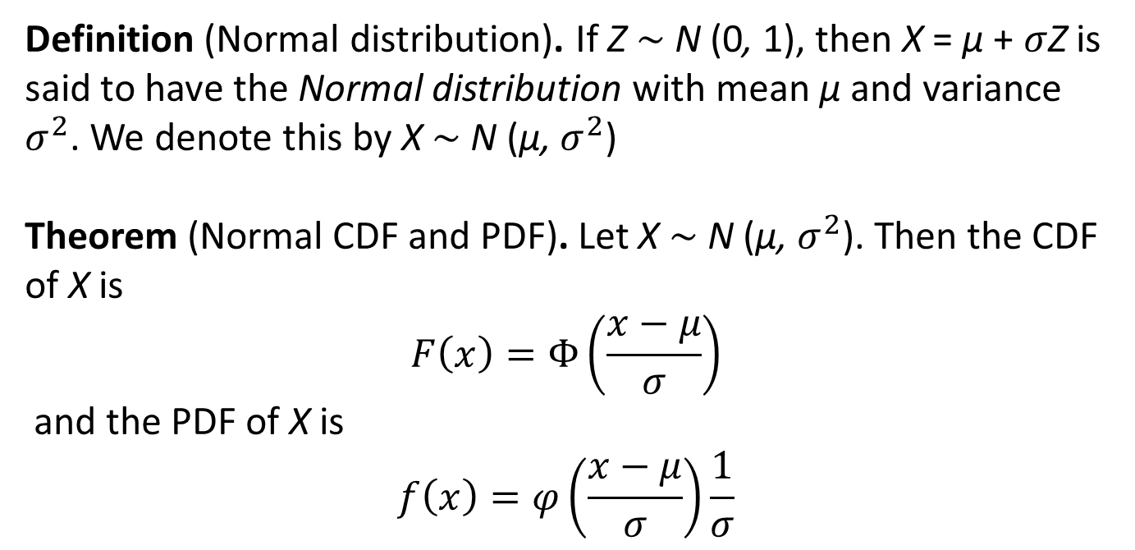
5.4 Normal distribution
Definition (Normal distribution). If Z $\sim$ N (0, 1), then X = µ + $σ$Z is said to have the Normal distribution with mean µ and variance $σ^{2}$. We denote this by X $\sim$ N (µ, $σ^{2}$)
Theorem (Normal CDF and PDF). Let X $\sim$ N (µ, $σ^{2}$). Then the CDF of X is $$F\left(x\right)=Φ\left(\frac{x−μ}{σ}\right)$$ and the PDF of X is
$$f\left(x\right)=φ\left(\frac{x−μ}{σ}\right)\frac{1}{σ}$$

Slide 31
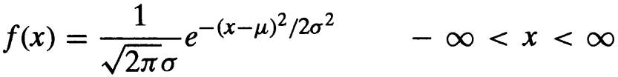
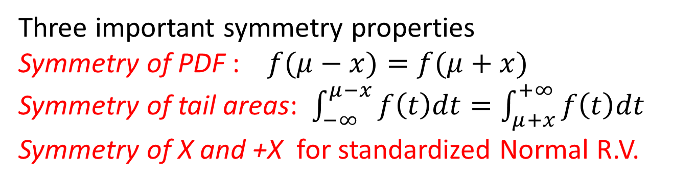
5.4 Normal distribution
Three important symmetry properties
Symmetry of PDF : $f(μ−x)=f(μ+x)$
Symmetry of tail areas: $\int_{−∞}^{μ−x}{f\left(t\right)dt}=\int_{μ+x}^{+∞}{f\left(t\right)dt}$
Symmetry of X and +X for standardized Normal R.V.

Slide 32
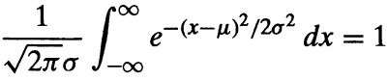
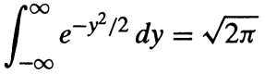
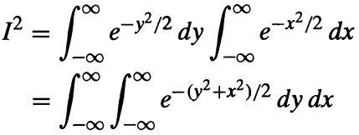
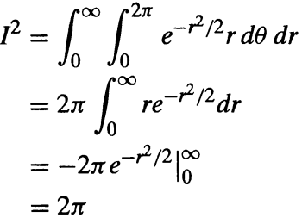
5.4 E(X) and Var(X) of Normal r.v.
1. Validation of normal X

Slide 33
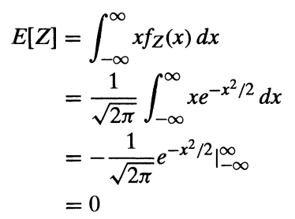
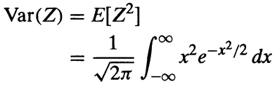
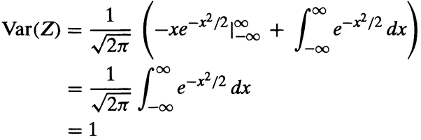
5.4 E(X) and Var(X) of Normal r.v.
2. E(X) and Var(X) for standard Normal r.v.

Slide 34
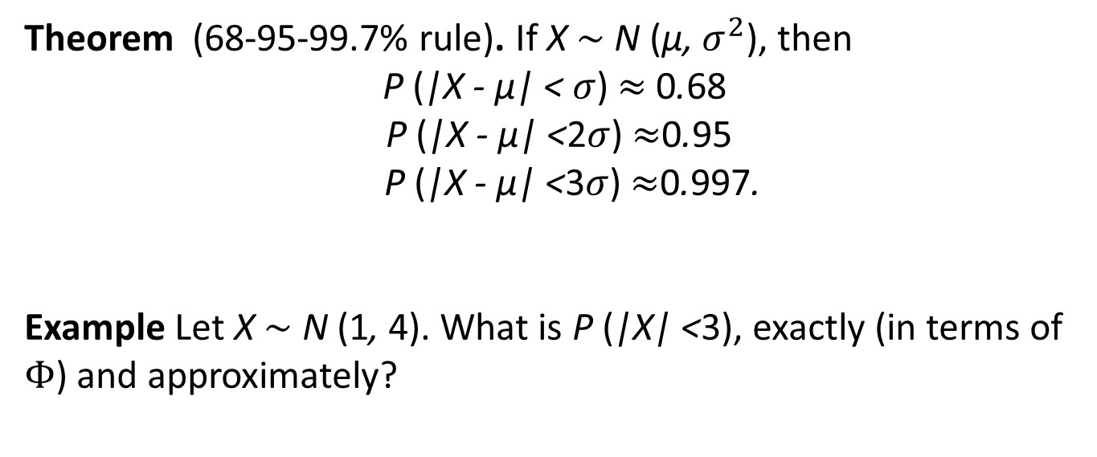
5.4 Normal distribution
Theorem (68-95-99.7% rule). If X $\sim$ N (µ, $σ^{2}$), then
P (|X - µ| <$σ$) $≈$ 0.68
P (|X - µ| <2$σ$) $≈$0.95
P (|X - µ| <3$σ$) $≈$0.997.
Example Let X $\sim$ N (1, 4). What is P (|X| <3), exactly (in terms of $Φ$) and approximately?

Slide 35
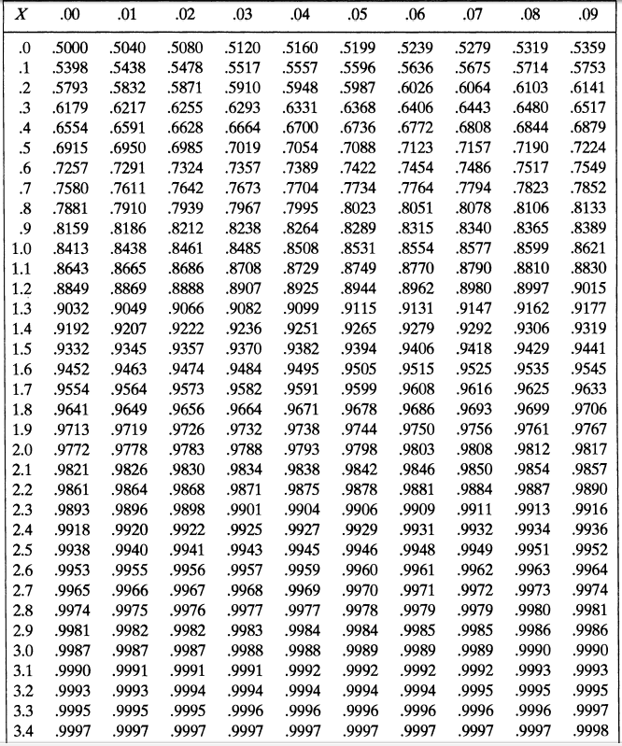
5.4 Normal distribution

Slide 36
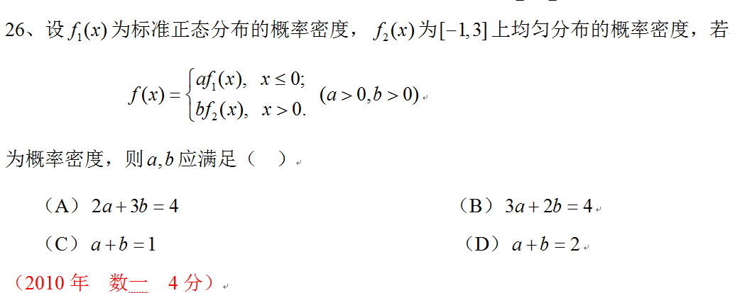
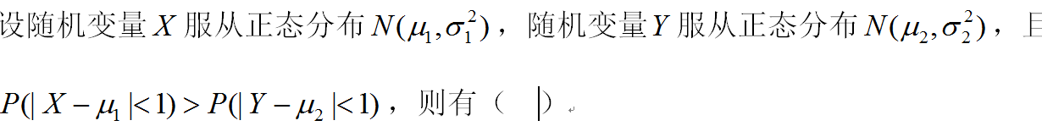
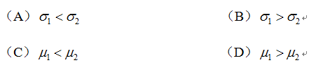

5.4 Normal distribution

Slide 37
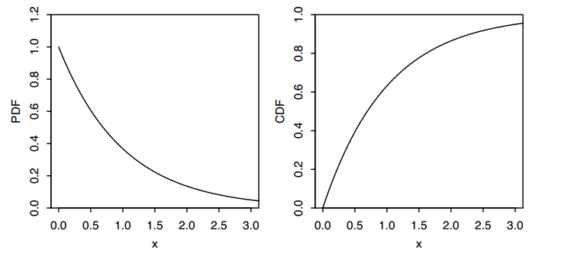
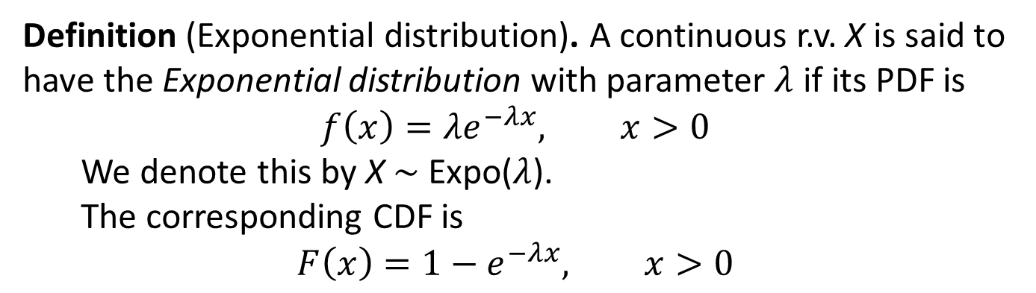
5.5 Exponential distribution
Definition (Exponential distribution). A continuous r.v. X is said to have the Exponential distribution with parameter $λ$ if its PDF is $$f\left(x\right)=λe^{−λx}, x>0$$
We denote this by X $\sim$ Expo($λ$). The corresponding CDF is
$$F\left(x\right)=1−e^{−λx}, x>0$$

Slide 38
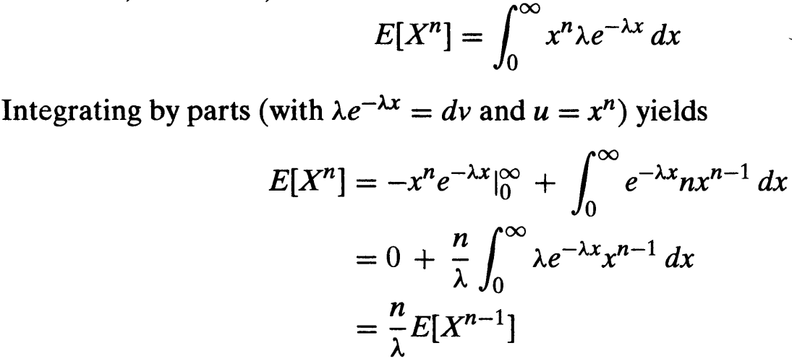
5.5 Exponential distribution
Definition (Exponential distribution). A continuous r.v. X is said to have the Exponential distribution with parameter $λ$ if its PDF is $$f\left(x\right)=λe^{−λx}, x>0$$
We denote this by X $\sim$ Expo($λ$). The corresponding CDF is
$$F\left(x\right)=1−e^{−λx}, x>0$$

Slide 39
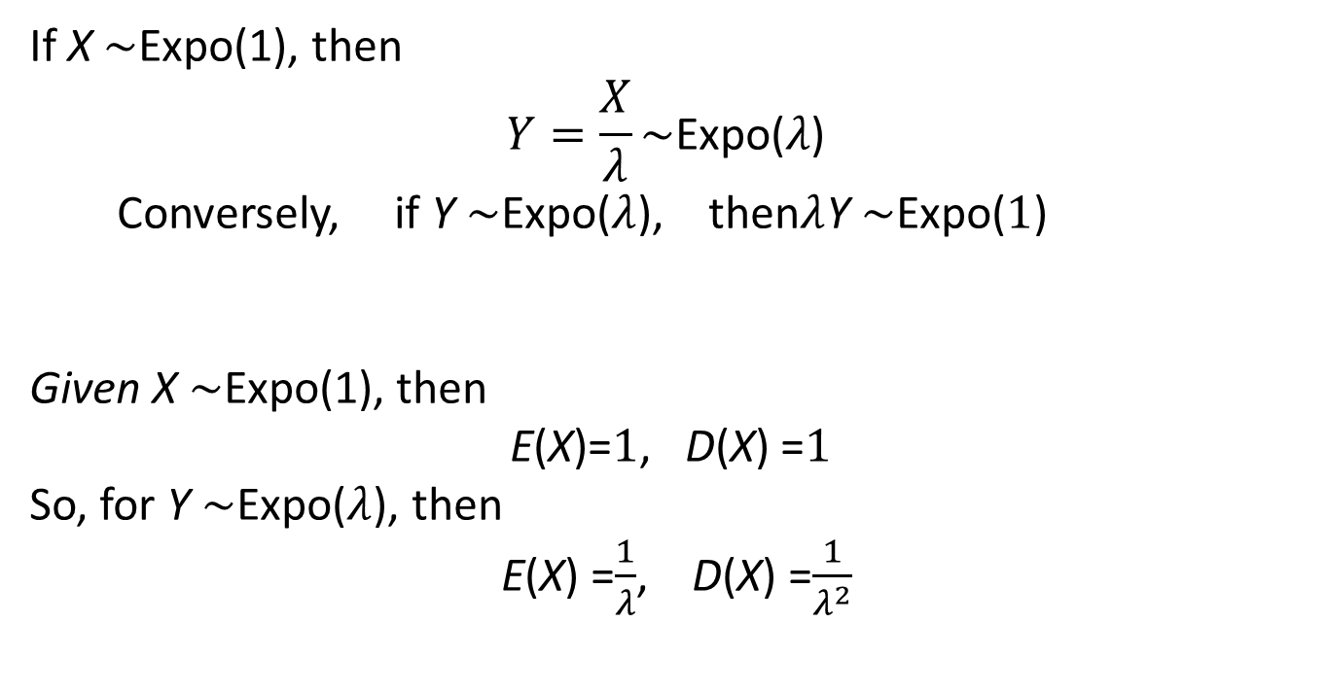
5.4 Exponential distribution
If X $\sim$Expo(1), then
$$Y=\frac{X}{λ}\sim \text{Expo}\text{(}λ\text{) }$$ Conversely, if Y $\sim$Expo($λ$), then$λ$Y $\sim$Expo($1$)
Given X $\sim$Expo(1), then
E(X)=$1$, D(X) =$1$
So, for Y $\sim$Expo($λ$), then
E(X) =$\frac{1}{λ}$, D(X) =$\frac{1}{λ^{2}}$

Slide 40


Raindrops again
Rain is falling on your head at an average speed of λ drops/second.
1
2
How long do we wait until the next drop?

Slide 41
Raindrops again
Probability model
Time is divided into intervals of length 1/n
Events E_{i} = “raindrop hits in interval i” have probability p = λ/n and are independent
X = interval of first drop
X
1
2
P(X = x)
= P(E₁^{c}…E_{x-1}^{c}E_{x})
= (1 – p)^{x-1}p

Slide 42
Raindrops again
X = interval of first drop
X = x
x-1
x
T
n
n
T = time (in seconds) of first drop
X = x
means that
(x – 1)/n ≤ T < x/n
P((x – 1)/n ≤ T < x/n) = P(X = x)
= (1 – p)^{x-1}p
= (1 – λ/n)^{x-1}(λ/n)

Slide 43
Raindrops again
T = time (in seconds) of first drop (continuous var)
P((x – 1)/n ≤ T < x/n) = (1 – λ/n)^{x-1}(λ/n)
If we set t = (x – 1)/n and δ = 1/n we get
P(t ≤ T < t + δ ) = (1 – δ λ)^{t/δ}(δλ)
= δλ e^{– (δ λ + o(δ λ)) t/δ}
P(t ≤ T < t + δ)
f(t) =
lim
= λ e^{-λt}
δ → 0
δ

Slide 44
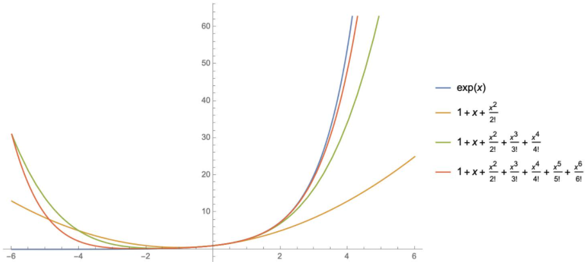
Raindrops again

Slide 45
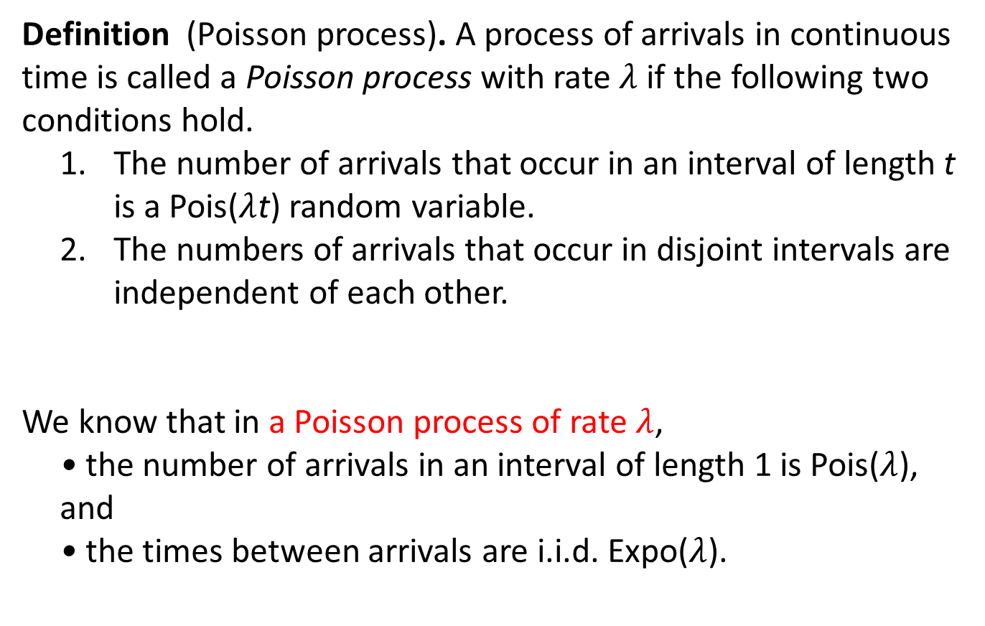
Poisson process
Definition (Poisson process). A process of arrivals in continuous time is called a Poisson process with rate $λ$if the following two conditions hold.
The number of arrivals that occur in an interval of length t is a Pois($λ$t) random variable.
The numbers of arrivals that occur in disjoint intervals are independent of each other.
We know that in a Poisson process of rate $λ$,
• the number of arrivals in an interval of length 1 is Pois($λ$), and • the times between arrivals are i.i.d. Expo($λ$).

Slide 46
The exponential random variable
The p.d.f. of an Exponential(λ) random variable T is
λ e^{-λt}
if x ≥ 0
f(t) =
0
if x < 0.
λ = 1
λ = 1
p.d.f. f(t)
c.d.f. F(t) = P(T ≤ t)

Slide 47
The exponential random variable
The c.d.f. of T is
ª
F(a) = ∫₀ λ e^{-λt} dt = e^{-λt}|₀ = 1 – e^{-λa}
if a ≥ 0
ª
What should the expected value of T be?
(Hint: Rain falls at λ drops/second
How many seconds till the first drop?)
E[T] = 1/λ
Var[T] = 1/λ²

Slide 48
Poisson vs. exponential
N
1
2
T
Poisson(λ)
Exponential(λ)
description
number of events within time unit
time until first event happens
expectation
λ
1/λ
std. deviation
λ
1/λ

Slide 49
Memoryless property
How much time between the second and third drop?
1
2
T
Solution
We start time when the second drop falls.
What happened before is irrelevant.
Then T is Exponential(λ)

Slide 50
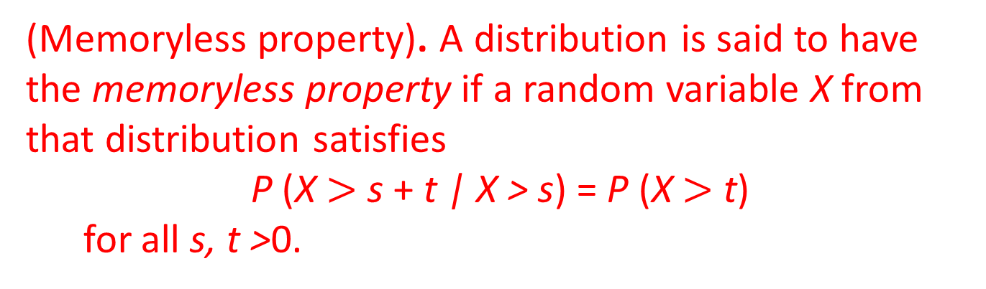
Memoryless property
How much time between the second and third drop?
1
2
T
(Memoryless property). A distribution is said to have the memoryless property if a random variable X from that distribution satisfies
P (X $>$ s + t | X > s) = P (X $>$ t)
for all s, t >0.

Slide 51
Expected time
What is the expected time of the third drop?
1
2
T
T₁
T₂
T₃
Solution
T = T₁ + T₂ + T₃
T is not exponential but
E[T] = E[T₁] + E[T₂] + E[T₃]
= 3/λ

Slide 52
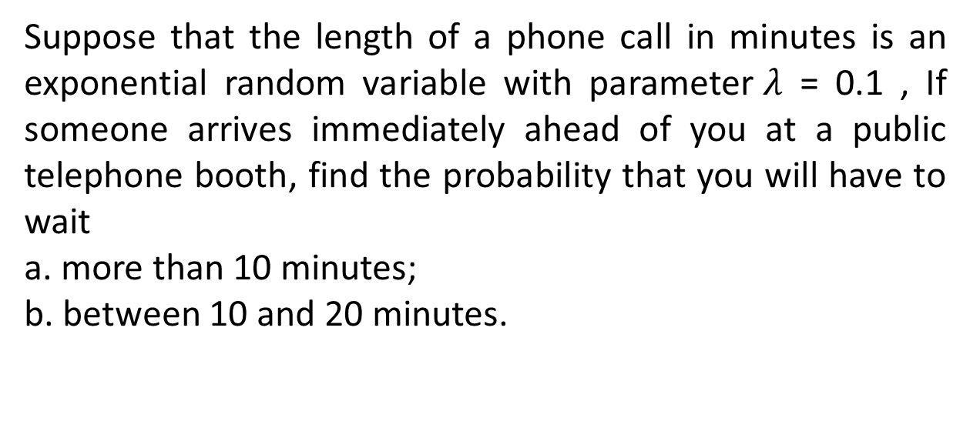
Example 5.g
Suppose that the length of a phone call in minutes is an exponential random variable with parameter$λ$ = 0.1 , If someone arrives immediately ahead of you at a public telephone booth, find the probability that you will have to wait
a. more than 10 minutes;
b. between 10 and 20 minutes.

Slide 53
5.6 Other distributions
Gamma distribution
Weibull distribution
Beta distribution
χ² distribution
Cauchy distribution

Slide 54
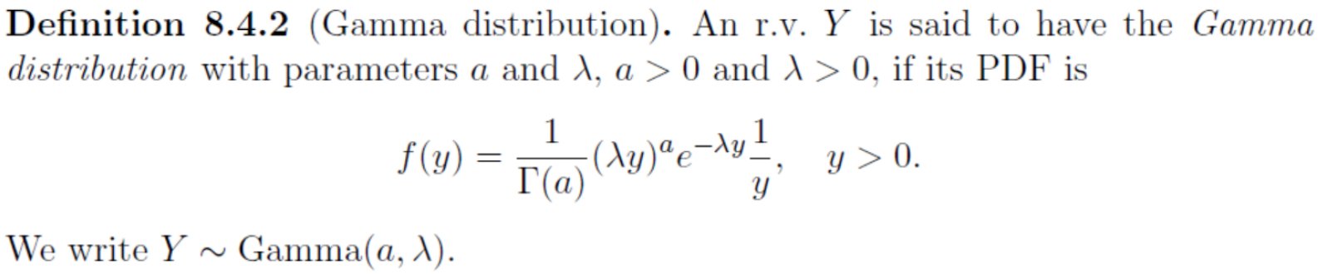
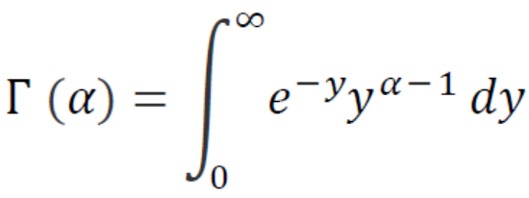
Gamma distribution
The Gamma distribution is a generalization of the Exponential distribution. An Exponential X represents the waiting time for the ﬁrst success under conditions of memorylessness, we shall see that a Gamma Y represents the total waiting time for multiple successes.

Slide 55
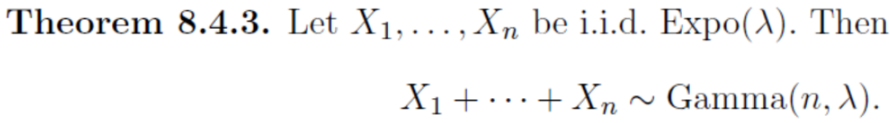
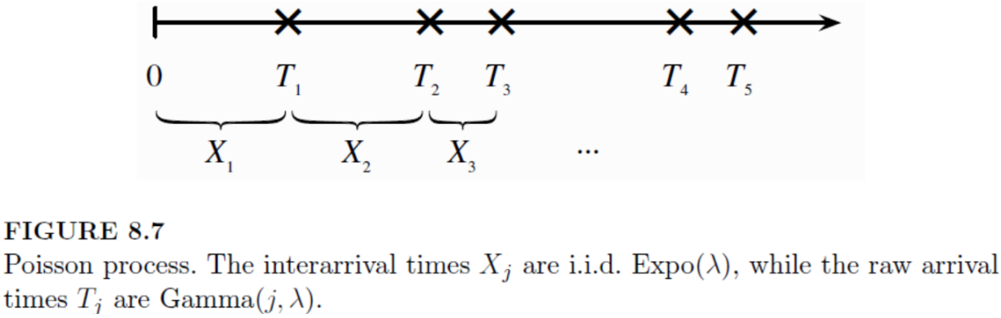
Gamma distribution
Note: i.i.d is independently identically distribution

Slide 56
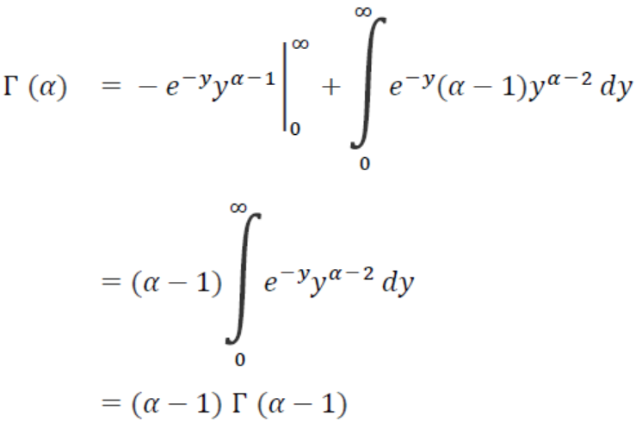
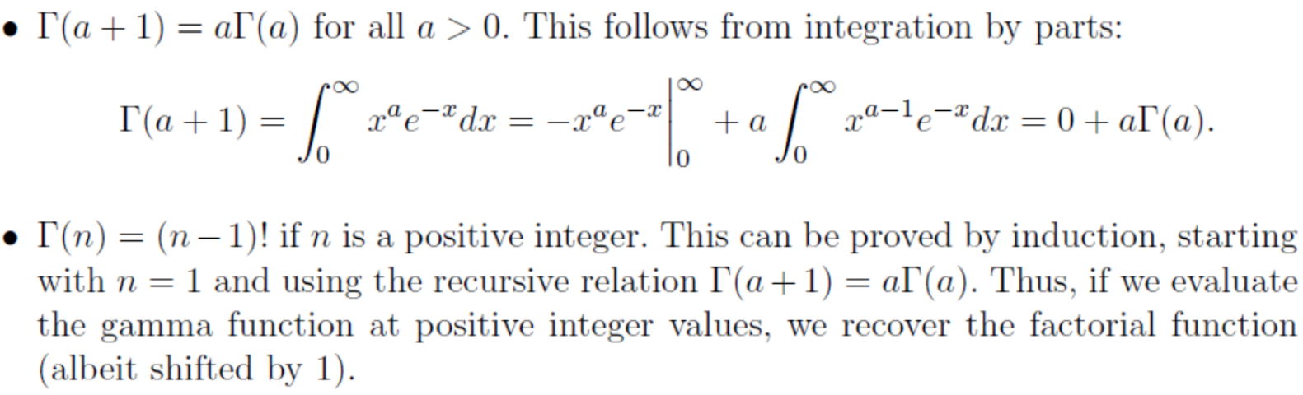
Gamma distribution

Slide 57
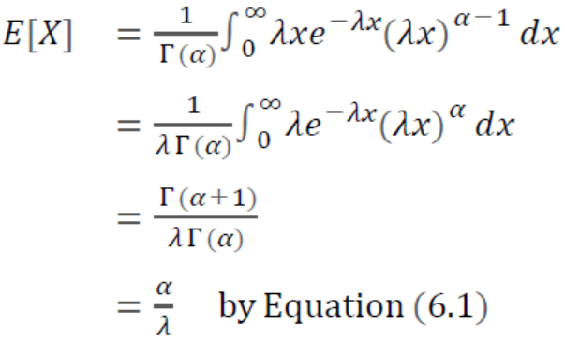

Gamma distribution

Slide 58

Gamma distribution

Slide 59
Beta distribution
The Beta distribution is a continuous distribution on the interval (0, 1). It is a generalization of the Unif(0, 1) distribution, allowing the PDF to be non-constant on (0, 1).
The beta distribution can be used to model a random phenomenon, whose set of possible values is some finite interval [c, d]—which, by letting denote the origin and taking d-c as a unit measurement, can be transformed into the interval [0, 1].
X , its values are in [c, d]
Y = (d-c)X+c, its values are in [0, 1]

Slide 60



Beta distribution
The Beta distribution’s PDF:
When a=1, b=1, it is r.v. distributed as Unif(0, 1);
Beta function is closely related to B(a,b)

Slide 61

Beta distribution
a=b=1: Beta(1,1) is Unif(0,1)
a<1,b<1: U-shape
a>1, b>1: Opens down
a=b: PDF is symmetric
about 0.5
a>b: right larger for PDF
a<b: left larger for PDF

Slide 62



Beta distribution’s Expectation and Variance

Slide 63

Relation between Beta and Gamma distributions

Slide 64

Chi-square distribution
Chi- square (χ²) distribution comes from the Normal distribution.
$Let Y_{1},⋯Y_{n}$ are independent Standard Normal r.v.
$$X=Y_{1}^{2}+⋯+Y_{n}^{2}$$
$X\sim χ^{2}\left(n\right), n$ is freedom degree.
It is applied in statistics.
The distribution is also expressed by Gamma distribution.

Slide 65


Chi-square distribution
In the case a = n/2 and λ = ½, the gamma distribution becomes the chi- square (χ²) distribution with n degrees of freedom.
The Chi-square (χ²) distribution with PDF
$$f\left(x\right)=\left\{\begin{matrix}\frac{{\left(\frac{1}{2}\right)}^{\frac{n}{2}}}{Γ\left(\frac{n}{2}\right)}x^{\frac{n}{2}−1}e^{−\frac{1}{2}x} & x≥0 \\ 0 & x<0\end{matrix}\right.$$
$$=\left\{\begin{matrix}\frac{1}{2^{\frac{n}{2}}Γ\left(\frac{n}{2}\right)}x^{\frac{n−2}{2}}e^{−\frac{x}{2}} & x≥0 \\ 0 & x<0\end{matrix}\right.$$

Slide 66
Weibull distribution
It was originally proposed for the interpretation of fatigue data, but now its use has been extended to many other engineering problems.
It is widely used in the field of life phenomena as the distribution of the lifetime of some object, especially when the “weakest link” model is appropriate for the object.
That is, consider an object consisting of many parts, and suppose that the object experiences death (failure) when any of its parts fails. It has been shown that under these conditions, a Weibull distribution provides a close approximation to the distribution of the lifetime of the item.

Slide 67


Weibull distribution
CDF
PDF

Slide 68
Weibull distribution
(α = 0.9, β = 2)
(α = 0.7, β = 2)
(α = 0.5, β = 2)
v=0

Slide 69


Cauchy distribution
Cauchy distribution come from the Normal distribution:
$$Y\sim Norm\left(0,1\right), Z\sim Norm\left(0,1\right)$$
$$X=\frac{Y}{Z}$$

Slide 70

5.7 Distribution of a Function of a continuous r.v.
Review discrete case:
In general, if X is a random variable and g a function, then
Y = g(X) is a random variable with p.m.f.
p_{Y}(y) = ∑_{x: g(x) = y} p_{X}(x).
P (Y = g(x)) = P (g(X) = g(x)) = P (X = x).

Slide 71

5.7 Distribution of a Function of a continuous r.v.
Continuous case:
X its PDF f(x)
Y = g(X) , To find f(y)
Basic rules:
Using PDF of X to find CDF of Y
$${ F}_{Y}(y)=P(Y≤y)=P(g(X)≤y)=P(X∈I_{g})=\int_{I_{g}}{f_{X}(x)}dx, \\ Here, I_{g}=\left\{x\left|g\left(x\right)≤y\right.\right\} a set$$
(2) $f_{Y}(y)=F_{Y}^{′}(y)$
Notes:
Range of Y and X, especially for Sectional function

Slide 72



Example 5.h
X ~ Unif(0, 1) Y = $X^{n}$, To find f(y)

Slide 73




Example 5.i
X~ f(x) Y = $X^{2}$, To find f(y)

Slide 74



Example 5.j
X~ f(x) Y = $\left|X\right|$, To find f(y)

Slide 75

5.7 Distribution of a Function of a continuous r.v.
X its PDF f(x)
Y = g(X) ,
Theorem:
Suppose that g(·) is a strictly monotonic (increasing or decreasing), differentiable (and thus continuous) function
Notes:
|·| means absolute operation

Slide 76




Example 5.k The Lognormal Distribution
If X is a normal random variable, X~ Norm($μ,σ^{2}$) Y = $e^{X}$,
To find f(y)

Slide 77

Example 5.m The Chi-quare Distribution

